Slide 1
How Do You Deliver?
An example of how technology changed the face of meetings and collaborations.

Slide 2
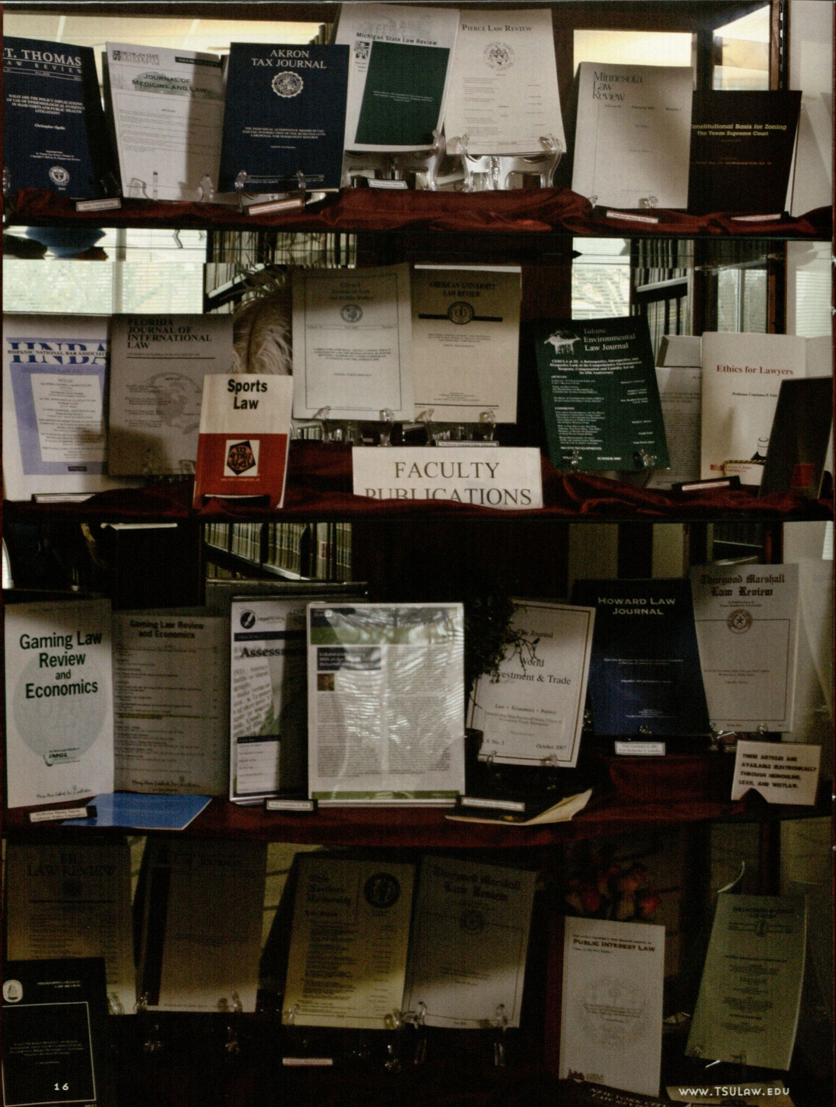
FACULTY SCHOLARSHIP CASE-Library
Notes:
Traditionally our library housed Faculty Scholarship within a display case.

Slide 3
Faculty Scholarship Display
LIBRARY
Traditional Showcasing
Hardcopies
Physical Exposure

Slide 4
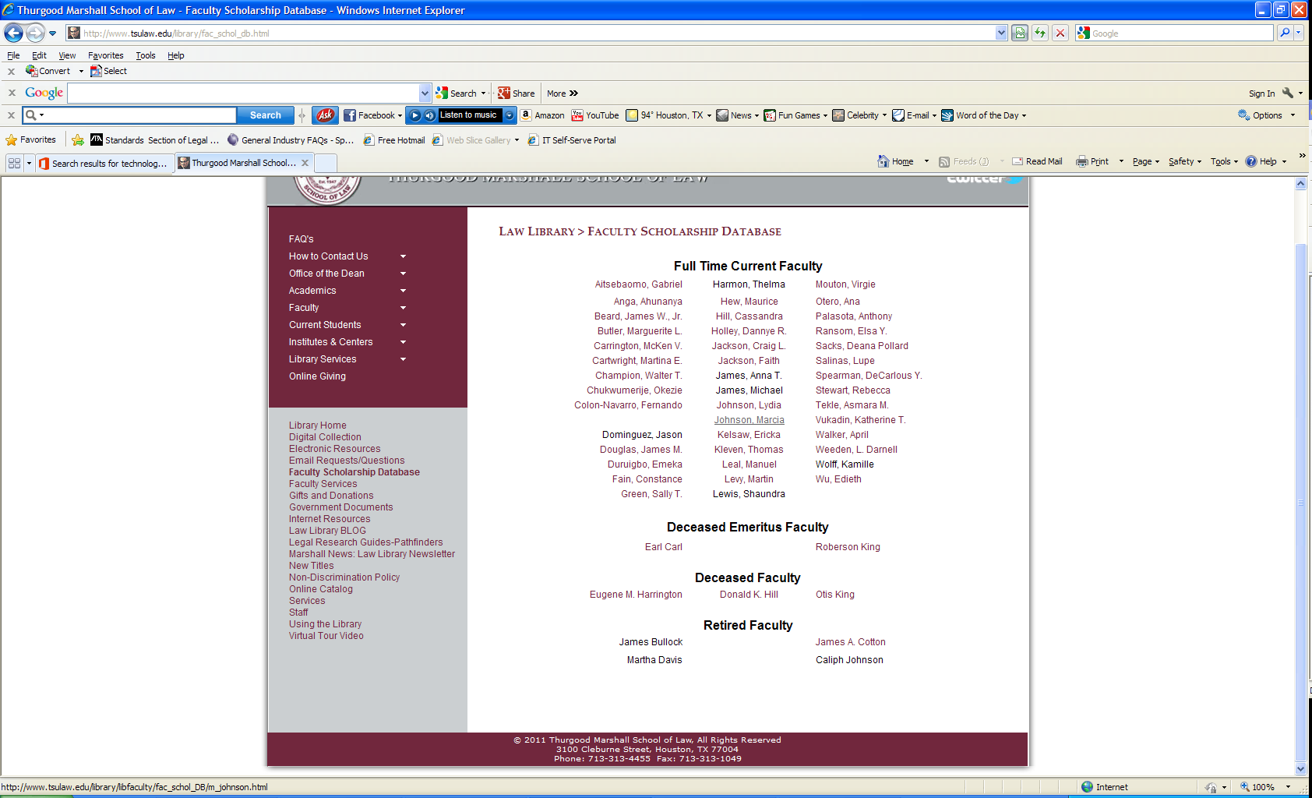
Faculty Scholarship Database- Library
Notes:
Our library director envisioned a Faculty Scholarship Database. This database was created to allow our law school community to have online access tofaculty scholarship via the library website.

Slide 5
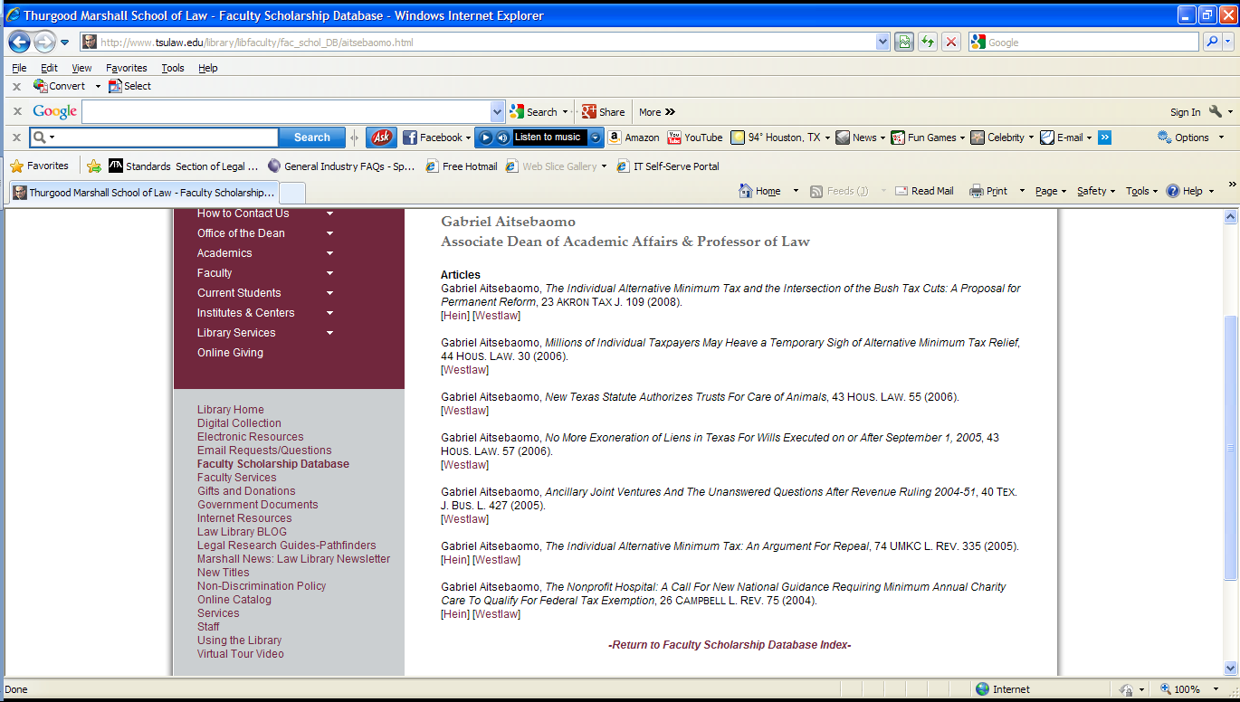
Linked Scholarship
Faculty Scholarship Database
Individualized faculty pages with links to Hein, Westlaw, and Lexis

Slide 6
Faculty Scholarship DATABASE- Information Technology
Reference Librarian emails current scholarship
Locate published scholarship within Hein, Westlaw, and Lexis
Hyperlink scholarship
Sent updates to our Web Developer, Stephen Zaptaka for website publishing

Slide 7
Faculty Scholarship
OFFICE OF THE DEAN
Marketing Faculty Scholarship
Broader Exposure
Faculty Scholarship PDF
Faculty Scholarship Brochure
Notes:
Dean Tekle, dean of Faculty Development, wanted broader exposure for faculty scholarship

Slide 8
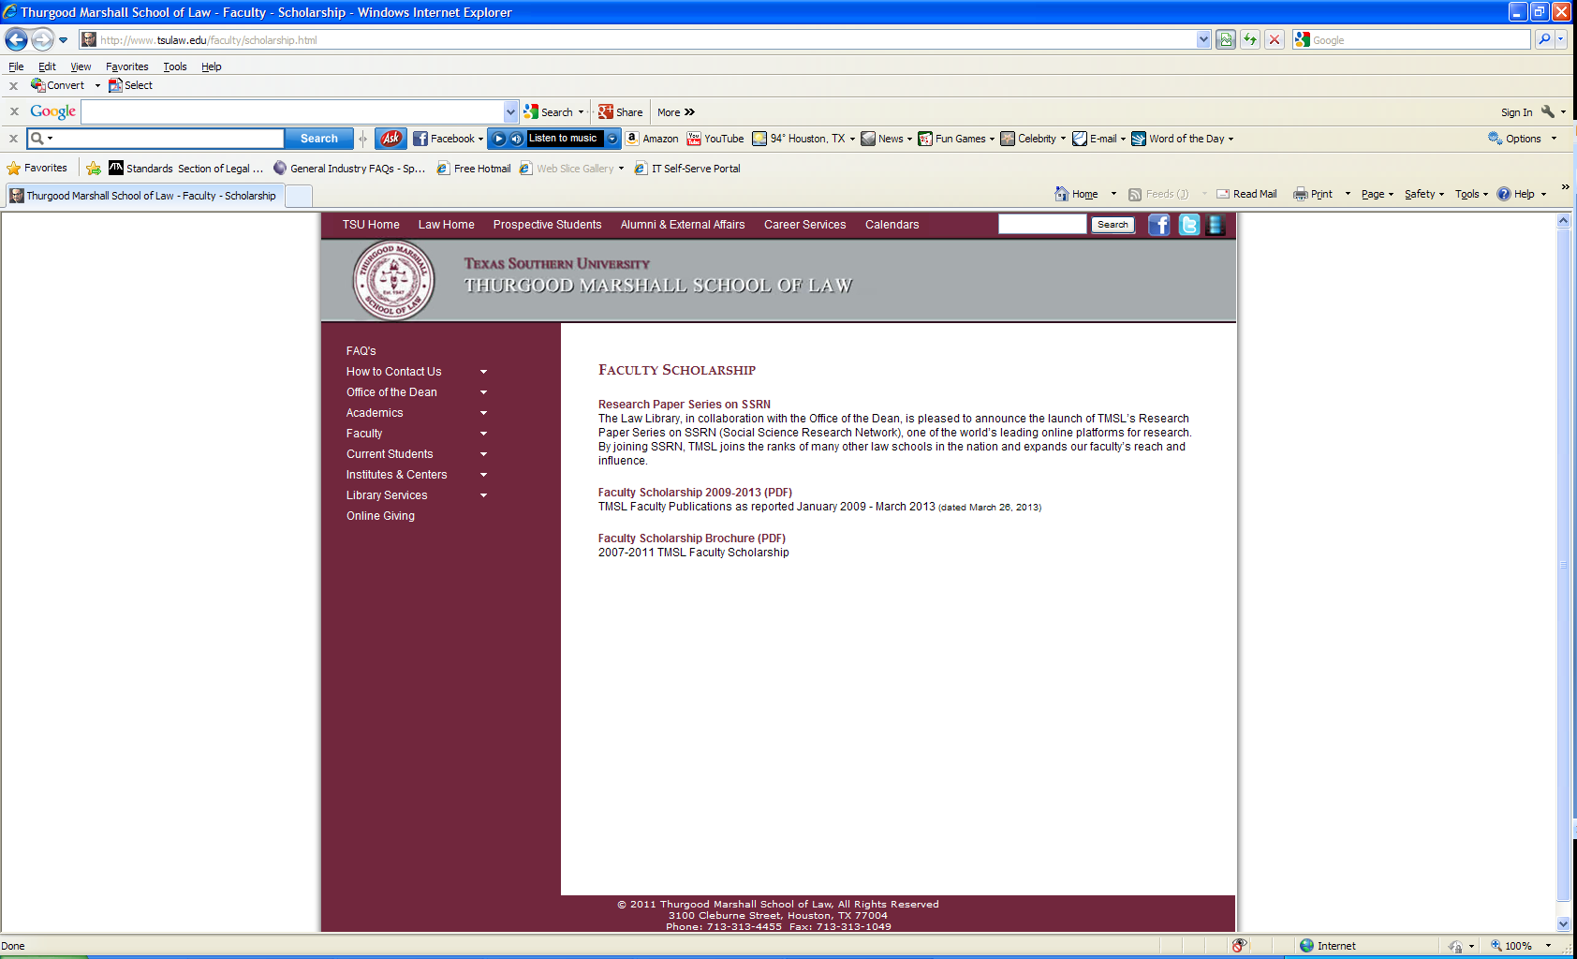
Faculty Scholarship
Notes:
Dean Tekle wanted several exposures via print, electronic, and online.

Slide 9

FACULTY SCHOLARSHIP BROCHURE

Slide 10
Faculty Scholarship Collaboration
Dean Tekle requested research on the Social Science Research Network’s (SSRN) Online Series
Stephen initiated contact with SSRN
SSRN Follow-up
Proposal
Office of the Dean approval

Slide 11
TMSL’s Research Paper Series
Thurgood Marshall School of Law’s (TMSL) Research Paper Series (RPS)
Basic vs. Full Plan
Editor-Dean Tekle
RPS Submitters- Shante/Faculty Librarian
Institutional SSRN Account
Faculty Services

Slide 12
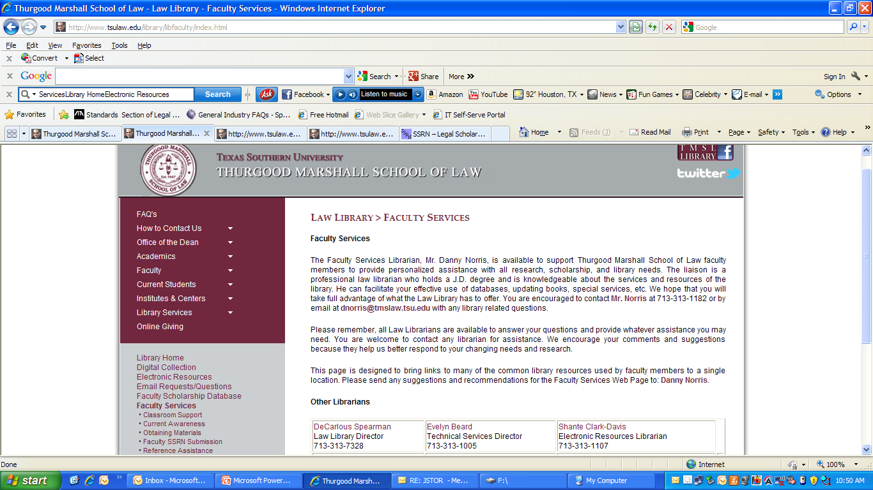
TMSL’s Research Paper Series-Library

Slide 13
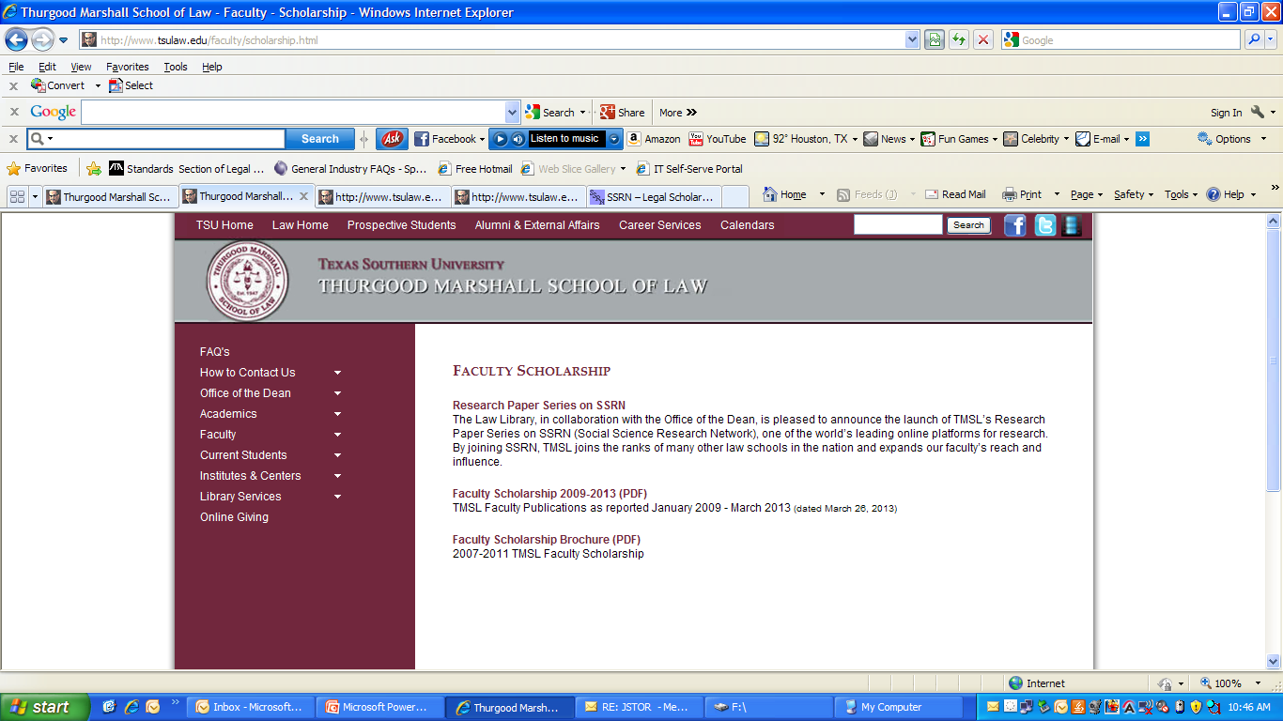
TMSL’s Research paper series- Office of the Dean

Slide 14
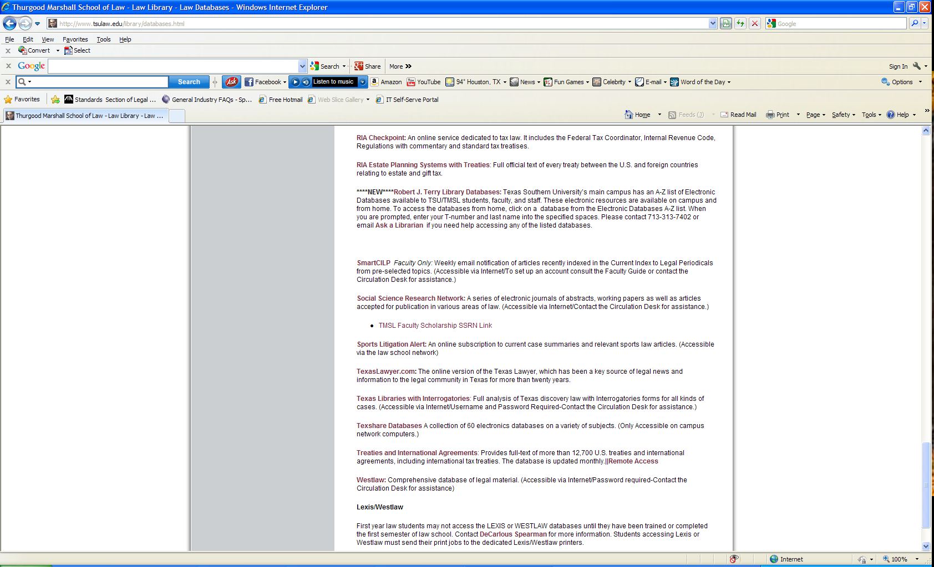
TMSL Research Paper Series-Library

Slide 15
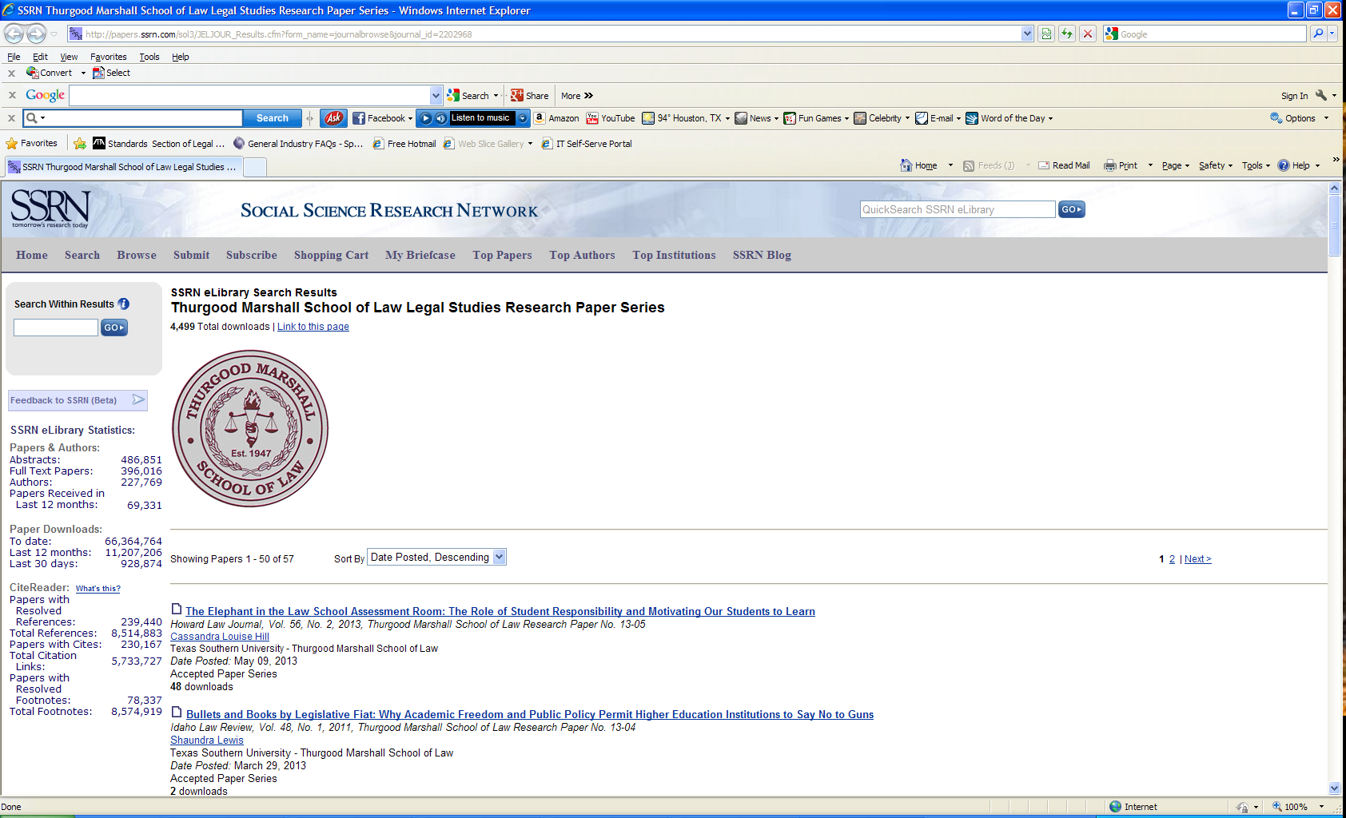
TMSL’S Research Paper Series

Slide 16
Questions AND ANSWERS
How Do You Deliver?

Slide 17
Contact Information
Asmara Tekle, Dean of Faculty Development
atekle@tmslaw.tsu.edu
Stephen Zapatka, Web Developer
szapatka@tmslaw.tsu.edu
Shante Clark-Davis, Electronic Resources Librarian
sfdavis@tmslaw.tsu.edu

